Slide 1
CSX4109 / ITX4109
ANDROID APPLICATION DEVELOPMENT

Slide 2
BASIC UI

Slide 3
JETPACK COMPOSE
Declarative UI Framework
Recomposition
Kotlin Only

Slide 4
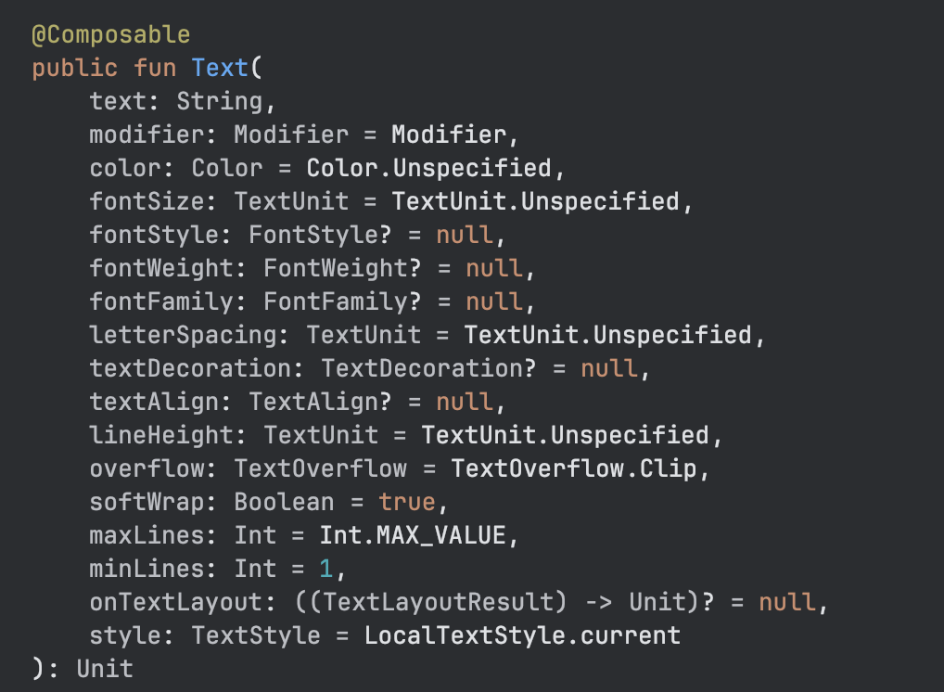
TEXT

Slide 5
FUNCTION (AGAIN)
// Example 1
fun sum(a: Int, b: Int): Int {
return a + b
}
// Example 2
fun sum(a: Int, b: Int) = a + b

Slide 6
FUNCTION (AGAIN)
// Example 1
fun sum(a: Int, b: Int): Int {
return a + b
}
// Example 2
val addedValue = sum(7, 3)
println(addedValue)

Slide 7
What if more parameters required?

Slide 8
SCENARIO
The function “sum” allows the user to input a magic number to be added to the summation of the “a” and “b”. If there is no a magical number entered, the result is the summation of the “a” and “b”
How do you handle this?

Slide 9
EASY AND SURE
// Without Magic
fun sum(a: Int, b: Int): Int {
return a + b
}
// With Magic
fun sum(a: Int, b: Int, magicNumber: Int): Int {
return a + b + magicNumber
}

Slide 10
BECOMING A POET
// Without Magic
fun sum(a: Int, b: Int): Int {
return a + b
}
// With Magic and Classy Function Name
fun sumWithMagic(a: Int, b: Int, magicNumber: Int): Int {
return a + b
}

Slide 11
BE A PRO
// With or Without Magic Supported
fun sum(a: Int, b: Int, magicNumber: Int = 0): Int {
return a + b + magicNumber
}
val addedValue = sum(7, 5)
val addedValueWithMagic = sum(7, 5, 13)

Slide 12
SCENARIO AGAIN
The function “sum” allows the user to input a magic number to be added to the summation of the “a” and “b”. It even allows the user enter a magical multiplication number to be multiplied along with the summation of the “a” and “b”. Still, those magic number for addition and magical multiplication number are optional. The user can specify one of them or both
How do you handle this?

Slide 13
BE AN EXPERT
// With or Without Magic Supported
fun sum(a: Int, b: Int, magicNumber: Int = 0, magicMultiplicationNumber: Int = 1): Int {
return (a + b + magicNumber) * magicMultiplicationNumber
}
val addedValue = sum(7, 5)
val addedValueWithMagic = sum(7, 5, 13)
Val addedValueWithMultiplication = sum(7, 5, magicMultiplicationNumber = 3)

Slide 14
EXCERCISE 1
Render a text on the screen with the following requirement
Color: Red
Style: Bold, Italic
Size: 24sp
Display Text: Hello Android

Slide 15
EXAMPLE

Slide 16
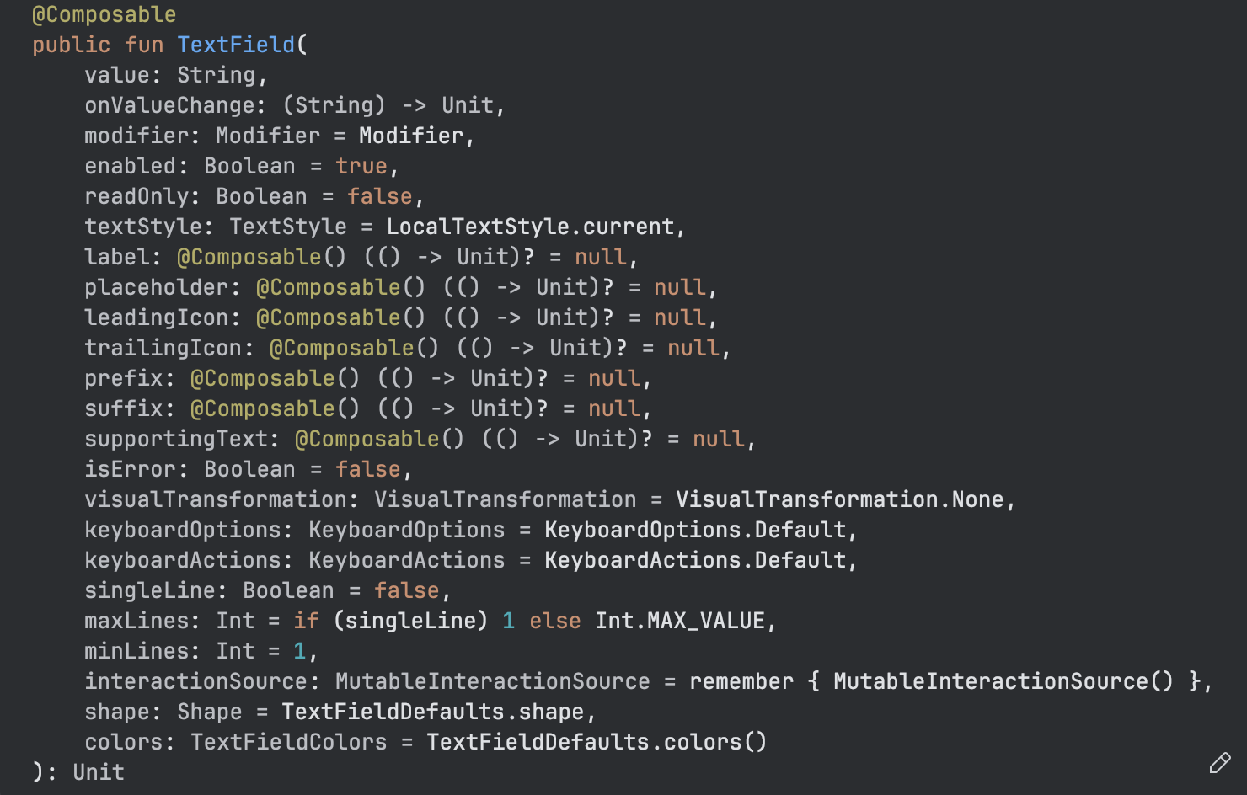
TEXTFIELD

Slide 17
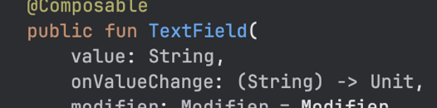
DID YOU NOTICE?
public fun TextField(value: String, onValueChanged: (String) -> Unit, ...)

Slide 18
FUNCTION AS PARAMETER
public fun TextField(value: String, onValueChanged: (String) -> Unit, ...)
onValueChanged —> Parameter Name
(String) —> Data Type of the Parameter
Unit —> Return Type of the Function in “onValueChanged”

Slide 19
LET’S GUESS
fun calculate(a: Int, b: Int, action: (Int, Int) -> Int): Int {
return action(a, b)
}
What is
calculate
a and b
action

Slide 20
EXAMPLE
fun calculate(a: Int, b: Int, action: (Int, Int) -> Int): Int {
return action(a, b)
}
fun sum(a: Int, b: Int): Int {
return a + b
}
println(calculate(4, 8, ::sum))

Slide 21
EXAMPLE 2 (SHORT VER.)
fun calculate(a: Int, b: Int, action: (Int, Int) -> Int): Int {
return action(a, b)
}
println(calculate(4, 8, { x, y -> x + y }))

Slide 22
EXCERCISE 2
Render a text field on the screen. The default value of the text field must be empty. If the user has not entered any values to the text field, there must be the text “Enter Text Here” as its placeholder in the text field. Once an input is entered, the placeholder must disappear and the input text is displayed instead

Slide 23
EXAMPLE

Slide 24
STATEFUL TEXTFIELD
var text by remember { mutableStateOf("") }
TextField(value = text,
onValueChange = { text = it },
placeholder = { Text("Enter Text Here") })

Slide 25
RECOMPOSITION
UI Regeneration when Needed
Only Related Parts Being Regenerated
Based on State

Slide 26
EXCERCISE 3
Render a button with the label “Click Here”. Once the button is clicked, show a dialog as a card with the text “Dialog Shown Here”

Slide 27
EXAMPLE

Slide 28
LAYOUT
Horizontal - Row
Vertical - Column
Stack - Box

Slide 29
LAYOUT
Horizontal - Row
Vertical - Column
Stack - Box
Name
CLICK

Slide 30
THANK YOU

